Slide 1
Data Mining Classification: Alternative Techniques
Lecture Notes for Chapter 4
Instance-Based Learning
Introduction to Data Mining , 2nd Edition
by
Tan, Steinbach, Karpatne, Kumar

Slide 2
Instance Based Classifiers
Examples:
Rote-learner
Memorizes entire training data and performs classification only if attributes of record match one of the training examples exactly
Nearest neighbor
Uses k “closest” points (nearest neighbors) for performing classification

Slide 3
Nearest Neighbor Classifiers
Basic idea:
If it walks like a duck, quacks like a duck, then it’s probably a duck
Compute Distance
Test Record
Training Records
Choose k of the “nearest” records

Slide 4
Nearest-Neighbor Classifiers
Requires three things
The set of labeled records
Distance Metric to compute distance between records
The value of k, the number of nearest neighbors to retrieve
To classify an unknown record:
Compute distance to other training records
Identify k nearest neighbors
Use class labels of nearest neighbors to determine the class label of unknown record (e.g., by taking majority vote)

Slide 5
Definition of Nearest Neighbor
K-nearest neighbors of a record x are data points that have the k smallest distances to x

Slide 6
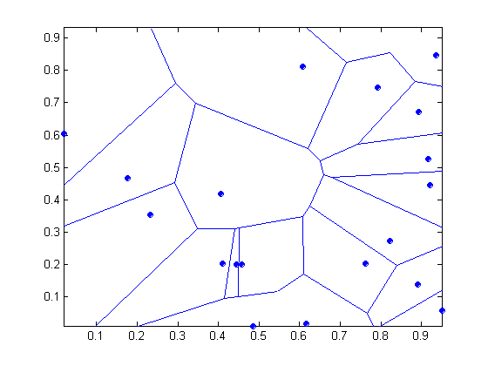
1 nearest-neighbor
Voronoi Diagram

Slide 7
Nearest Neighbor Classification
Compute distance between two points:
Euclidean distance
Determine the class from nearest neighbor list
Take the majority vote of class labels among the k-nearest neighbors
Weigh the vote according to distance
weight factor, w = 1/d²

Slide 8
Nearest Neighbor Classification…
Choosing the value of k:
If k is too small, sensitive to noise points
If k is too large, neighborhood may include points from other classes

Slide 9
Nearest Neighbor Classification…
Scaling issues
Attributes may have to be scaled to prevent distance measures from being dominated by one of the attributes
Example:
height of a person may vary from 1.5m to 1.8m
weight of a person may vary from 90lb to 300lb
income of a person may vary from $10K to $1M

Slide 10
Nearest Neighbor Classification…
Selection of the right similarity measure is critical:
1 1 1 1 1 1 1 1 1 1 1 0
0 0 0 0 0 0 0 0 0 0 0 1
vs
0 1 1 1 1 1 1 1 1 1 1 1
1 0 0 0 0 0 0 0 0 0 0 0
Euclidean distance = 1.4142 for both pairs

Slide 11
Nearest neighbor Classification…
k-NN classifiers are lazy learners since they do not build models explicitly
Classifying unknown records are relatively expensive
Can produce arbitrarily shaped decision boundaries
Easy to handle variable interactions since the decisions are based on local information
Selection of right proximity measure is essential
Superfluous or redundant attributes can create problems
Missing attributes are hard to handle

Slide 12
Improving KNN Efficiency
Avoid having to compute distance to all objects in the training set
Multi-dimensional access methods (k-d trees)
Fast approximate similarity search
Locality Sensitive Hashing (LSH)
Condensing
Determine a smaller set of objects that give the same performance
Editing
Remove objects to improve efficiency

Slide 13
KNN and Proximity Graphs
Proximity graphs
a graph in which two vertices are connected by an edge if and only if the vertices satisfy particular geometric requirements
nearest neighbor graphs,
minimum spanning trees
Delaunay triangulations
relative neighborhood graphs
Gabriel graphs
See recent papers by Toussaint
G. T. Toussaint. Proximity graphs for nearest neighbor decision rules: recent progress. In Interface-2002, 34th Symposium on Computing and Statistics, ontreal, Canada, April 17–20 2002.
G. T. Toussaint. Open problems in geometric methods for instance based learning. In Discrete and Computational Geometry, volume 2866 of Lecture Notes in Computer Science, pages 273–283, December 6-9, 2003.
G. T. Toussaint. Geometric proximity graphs for improving nearest neighbor methods in instance-based learning and data mining. Int. J. Comput. Geometry Appl., 15(2):101–150, 2005.

